Slide 1
Term Project
Journal Manager System
Catharine & Noah Wisniewski

Slide 2
Overview
This project is a Windows Forms application designed to manage journal files. It tracks changes made to .txt files and logs them in corresponding journal files. The user can also perform basic file management tasks such as creating, renaming, and deleting text files.

Slide 3
Importance
Managing text files and tracking their changes is critical for many applications, whether for keeping a history of edits or maintaining logs. This system simplifies these tasks, providing an intuitive interface for users to manage and track file changes in a folder.

Slide 4
Technology Used
Language: C# (Windows Forms)
Platform: .NET Framework (Windows platform)
Tools:
Visual Studio (IDE)
Windows Forms (for GUI)
FileSystemWatcher (for real-time file tracking)
Key Components:
GUI: A user-friendly interface that allows users to manage files and view the associated journal entries

Slide 5
Features of the Program
Create and Manage Files: Users can create, delete, and open .txt files directly from the application.
Automatic Change Tracking: Changes made to any .txt file are automatically tracked and logged in the corresponding journal file.
Journal File Management: Each text file has a corresponding journal that logs changes such as edits, deletions, and creations.
File Operations Monitoring: Using FileSystemWatcher, the program automatically monitors the folder for changes to files and triggers the corresponding actions.
File Rebuild: The system allows users to rebuild a text file from its journal, useful for recovering data or analyzing changes over time.

Slide 6
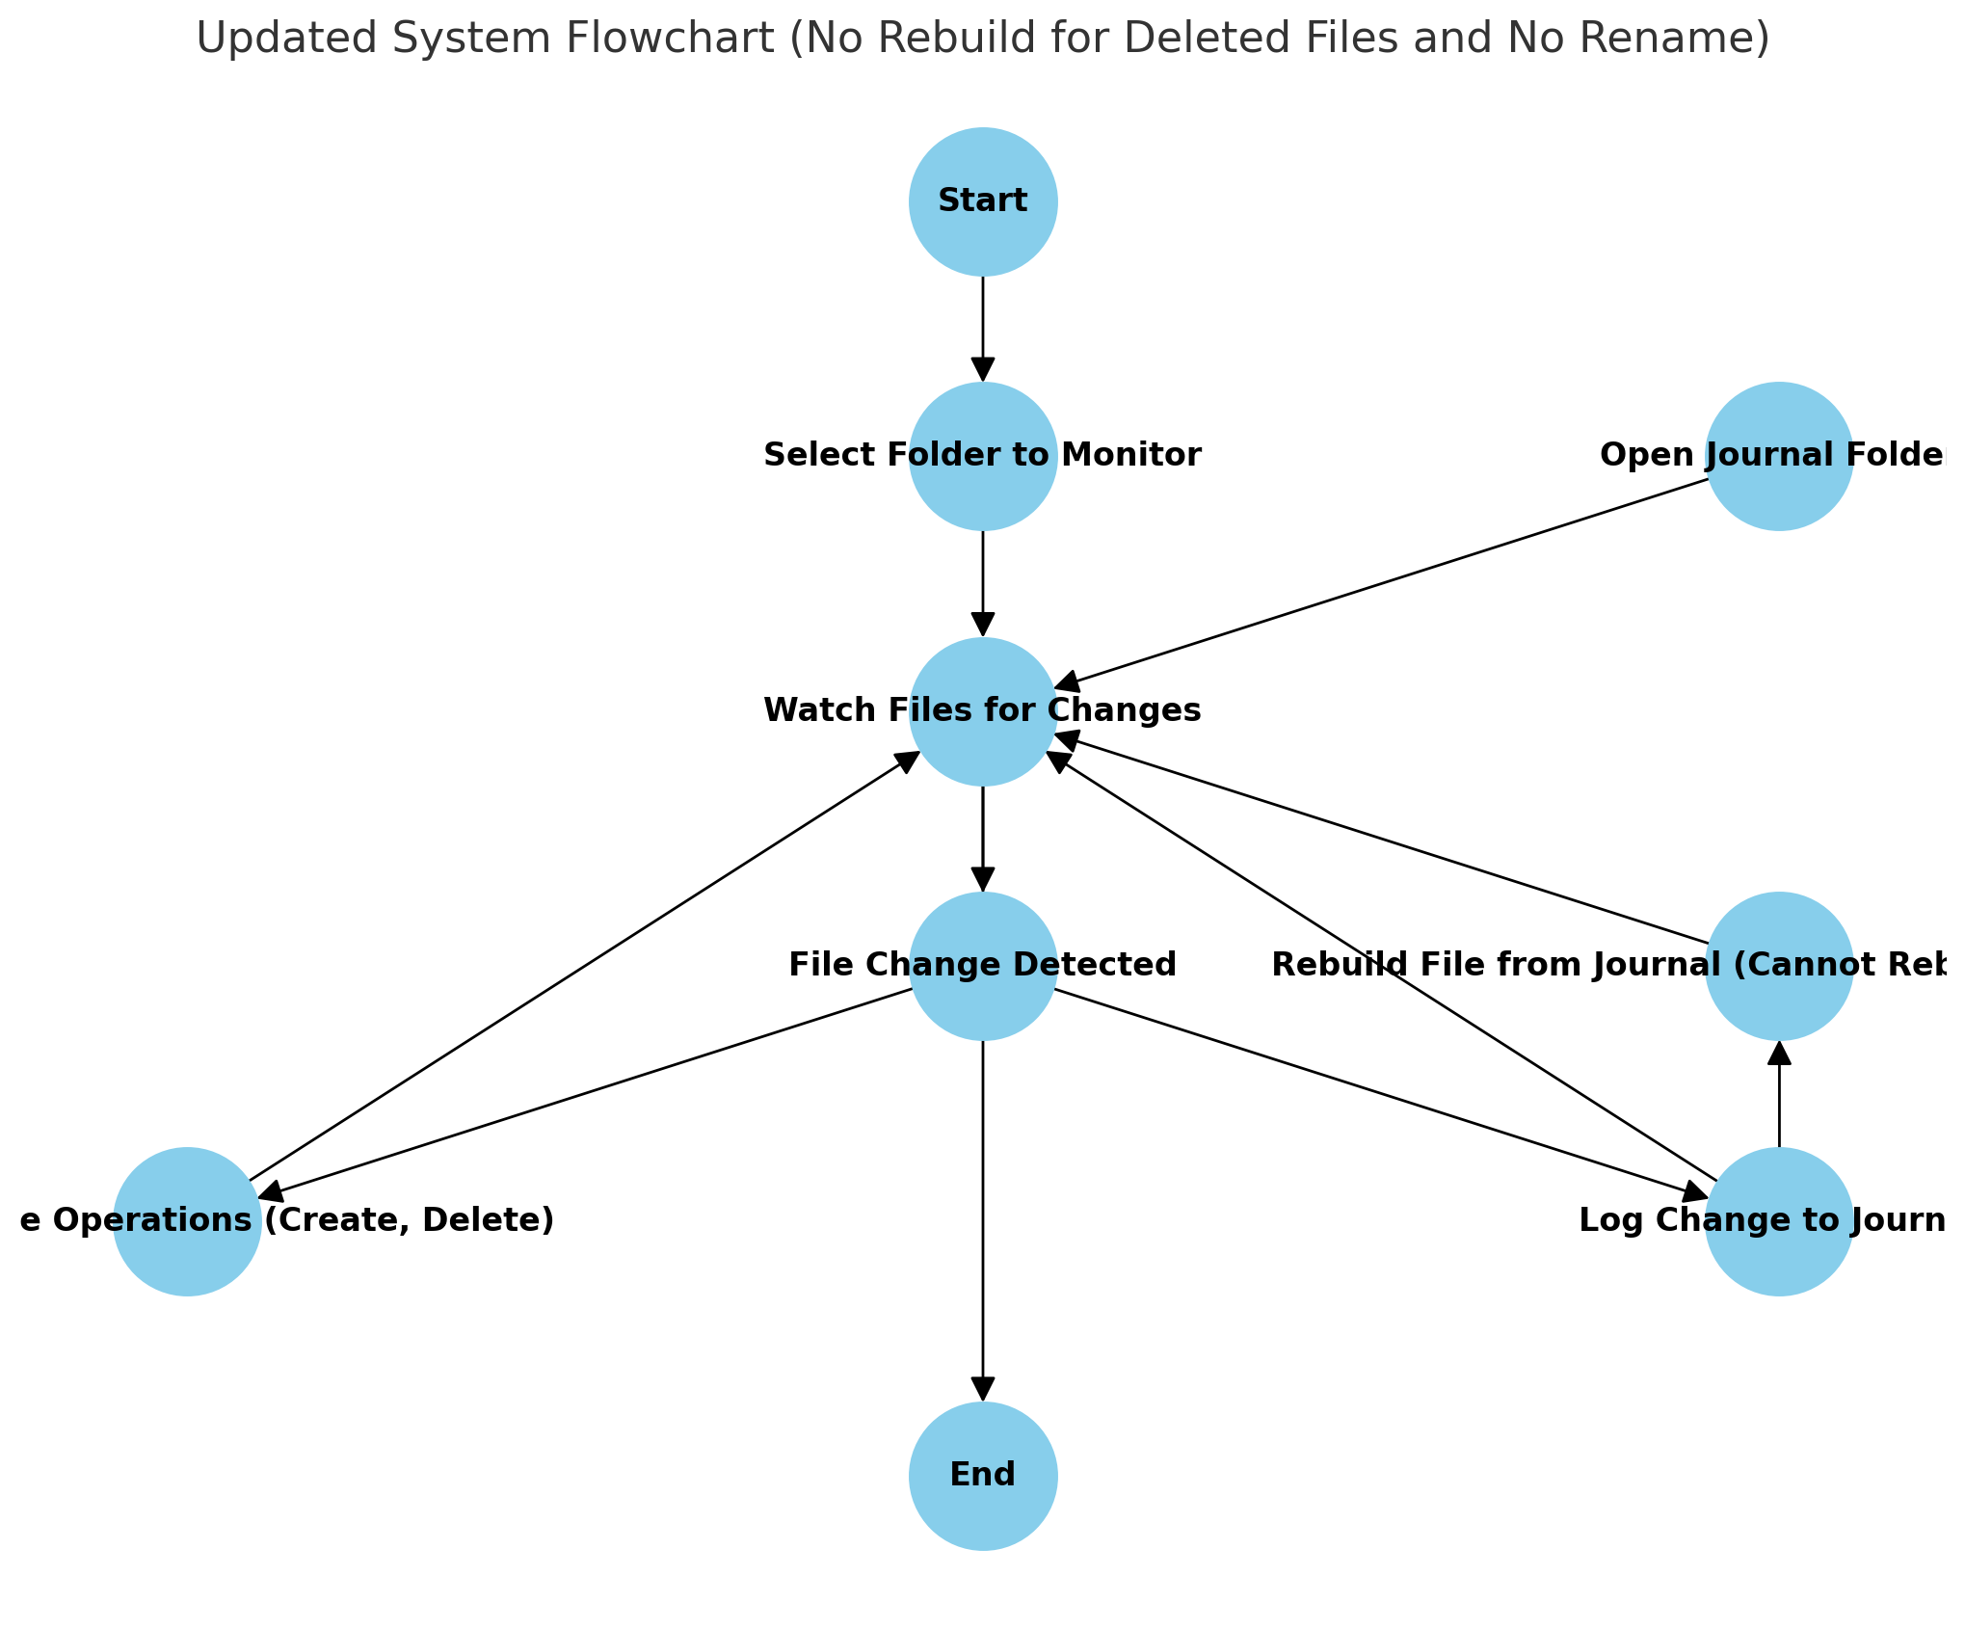
System FlowChart

Slide 7
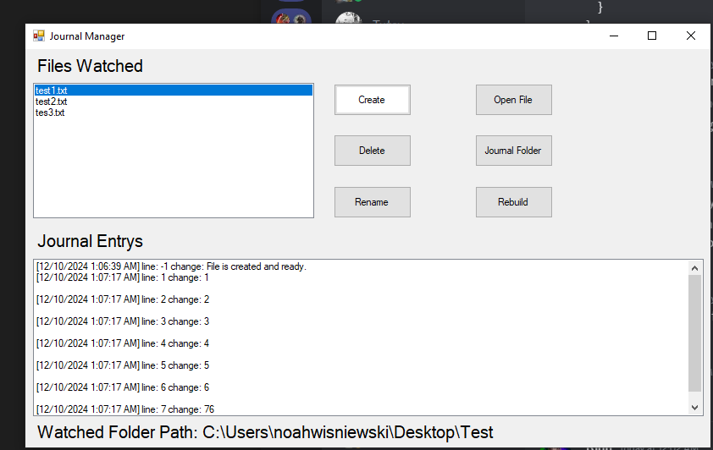

Slide 8
Challenges
No Rename Functionality:
The application currently does not support renaming files, limiting the ability to modify file names after creation
No Duplicate Names
The system cannot handle files with the same name

Slide 9
Conclusion
The Journal Manager System provides an easy-to-use tool for managing and tracking changes to text files, helping users maintain logs and histories of their file edits.
it is important to maintain accurate logs of changes made to documents, files, or records. Whether it is for regulatory compliance, keeping a history of edits, or simply organizing files, this system simplifies the task of tracking and managing file modifications.

